Slide 1
Swarm Intelligence
Also known as
- Artificial Life Computation
- Evolutionary Computation

Slide 2

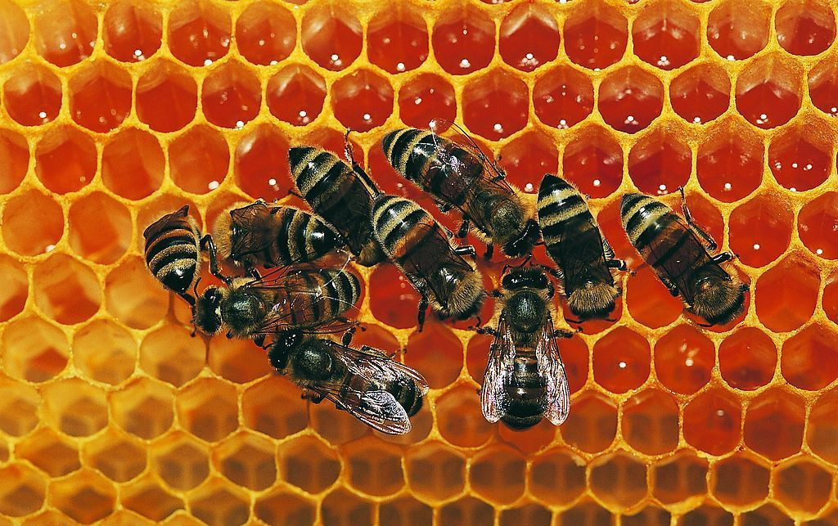



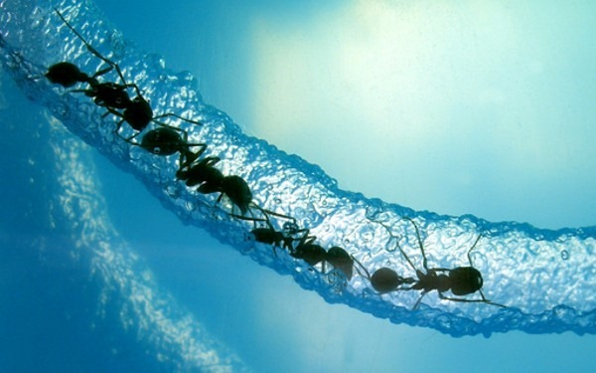

Personal experience
+
Social experience

Slide 3
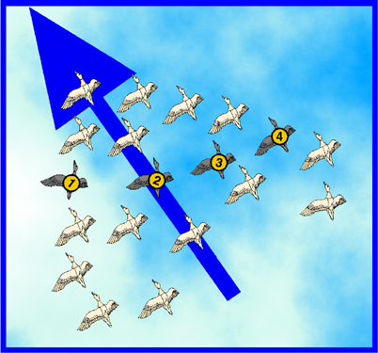
The Particle Swarm Optimization Algorithm

Slide 4
Summary
Introduction to Particle Swarm Optimization (PSO)
Origins
Concept
PSO Algorithm
PSO for the Bin Packing Problem (BPP)
Problem Formulation
Algorithm
Simulation Results

Slide 5


Introduction to the PSO: Origins
Inspired from the nature social behavior and dynamic movements with communications of insects, birds and fish

Slide 6
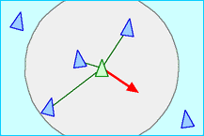
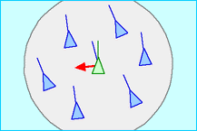
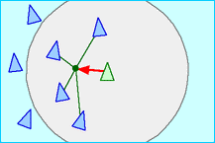
Introduction to the PSO: Origins
In 1986, Craig Reynolds described this process in 3 simple behaviors:
Separation
avoid crowding local flockmates
Alignment
move towards the average heading of local flockmates
Cohesion
move toward the average position of local flockmates

Slide 7
Introduction to the PSO: Origins
Application to optimization: Particle Swarm Optimization
Proposed by James Kennedy & Russell Eberhart (1995)
Combines self-experiences with social experiences

Slide 8
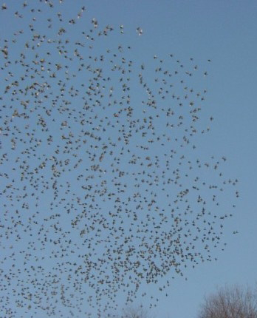
Introduction to the PSO: Concept
Uses a number of agents (particles) that constitute a swarm moving around in the search space looking for the best solution
Each particle in search space adjusts its “flying” according to its own flying experience as well as the flying experience of other particles

Slide 9
Introduction to the PSO: Concept
Collection of flying particles (swarm) - Changing solutions
Search area - Possible solutions
Movement towards a promising area to get the global optimum
Each particle keeps track:
its best solution, personal best, pbest
the best value of any particle, global best, gbest

Slide 10
Introduction to the PSO: Concept
Each particle adjusts its travelling speed dynamically corresponding to the flying experiences of itself and its colleagues
Each particle modifies its position according to:
its current position
its current velocity
the distance between its current position and pbest
the distance between its current position and gbest

Slide 11
Introduction to the PSO: Algorithm - Neighborhood
geographical
social

Slide 12
Introduction to the PSO: Algorithm - Neighborhood
global

Slide 13
Introduction to the PSO: Concept
Each particle adjusts its travelling speed dynamically corresponding to the flying experiences of itself and its colleagues
Each particle modifies its position according to:
its current position
its current velocity
the distance between its current position and pbest
the distance between its current position and gbest

Slide 14
Introduction to the PSO: Algorithm - Parameters
Algorithm parameters
A : Population of agents
p_{i} : Position of agent a_{i} in the solution space
f : Objective function
v_{i} : Velocity of agent’s a_{i}
V(a_{i}) : Neighborhood of agent a_{i} (fixed)
The neighborhood concept in PSO is not the same as the one used in local search, since in PSO each particle’s neighborhood never changes (is fixed)

Slide 15
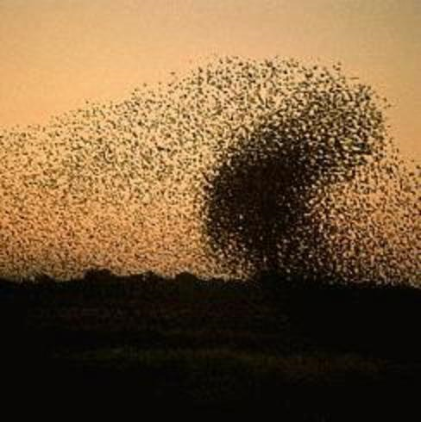
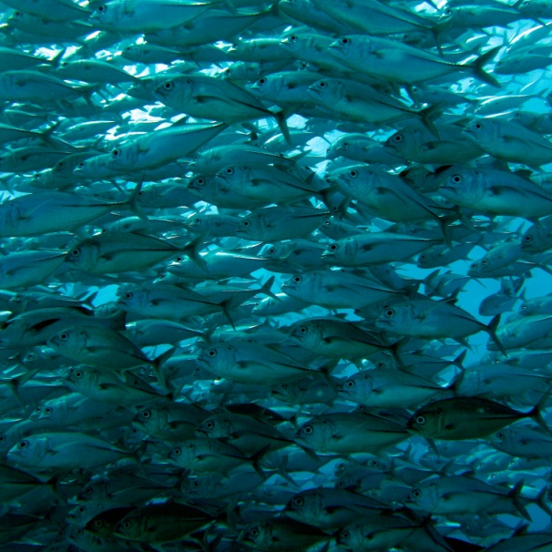
Introduction to the PSO: Algorithm
[x*] = PSO()
P = Particle_Initialization();
For i=1 to it_max
For each particle p in P do
fp = f(p);
If fp is better than f(pBest)
pBest = p;
end
end gBest = best p in P;
For each particle p in P do
v = v + c1*rand*(pBest – p) + c2*rand*(gBest – p);
p = p + v; end end

Slide 16
Introduction to the PSO: Algorithm
[x*] = PSO()
P = Particle_Initialization();
For i=1 to it_max
For each particle p in P do
fp = f(p);
If fp is better than f(pBest)
pBest = p;
end
end gBest = best p in P;
For each particle p in P do
v = v + c1*rand*(pBest – p) + c2*rand*(gBest – p);
p = p + v; end end

Slide 17
Introduction to the PSO: Algorithm
[x*] = PSO()
P = Particle_Initialization();
For i=1 to it_max
For each particle p in P do
fp = f(p);
If fp is better than f(pBest)
pBest = p;
end
end gBest = best p in P;
For each particle p in P do
v = v + c1*rand*(pBest – p) + c2*rand*(gBest – p);
p = p + v; end end

Slide 18
Introduction to the PSO: Algorithm
Particle update rule
p = p + v
with
v = v + c₁ * rand * (pBest – p) + c₂ * rand * (gBest – p)
where
p: particle’s position
v: path direction
c₁: weight of local information
c₂: weight of global information
pBest: best position of the particle
gBest: best position of the swarm
rand: random variable
Notes:
c1, c2 : The balance factors between the effect of self-knowledge and social knowledge in moving the particle towards the target. Usually the value 2 is suggested for both factors in the literature)
rand :A random number between 0 and 1, and different at each iteration
w : Inertia weight
pbest : The best position of a particle
gbest : The best position within the swarm
prtvel : The velocity of jth particle in ith iteration
prtpos : The position of jth particle in ith iteration

Slide 19
Introduction to the PSO: Algorithm - Parameters
Number of particles usually between 10 and 50
C₁ is the importance of personal best value
C₂ is the importance of neighborhood best value
Usually C₁ + C₂ = 4 (empirically chosen value)
If velocity is too low → algorithm too slow
If velocity is too high → algorithm too unstable

Slide 20
Introduction to the PSO: Algorithm
Create a ‘population’ of agents (particles) uniformly distributed over X
Evaluate each particle’s position according to the objective function
If a particle’s current position is better than its previous best position, update it
Determine the best particle (according to the particles’ previous best positions)

